Slide 1
How Wall Street Does Continuous Delivery
Manuel Edwards

Slide 2
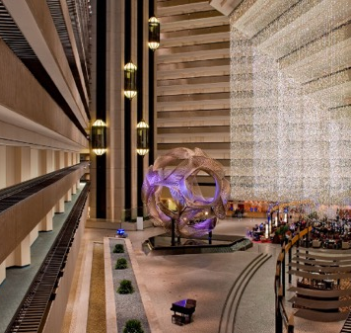
Welcome to DevOps Enterprise 2015!
About the speaker
Manuel Edwards
Born in Mexico City (Hola a Miguel de Icaza y a todos los Linuxeros de Mexico)
Started programing at 12
B.S. in Computer Science Binghamton University (Upstate NY)
Lead of Build and Release at E*TRADE Financial
7+ years of experience in bringing down the walls between Dev and Ops

Slide 3



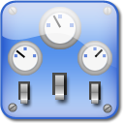
Agenda
Configuration Management
Change propagation
software Engineering disciplines
automation

Slide 4
Important Disclaimers
GENERAL INFORMATION ONLY – NOT FINANCIAL ADVICE The opinions and views expressed at or through this presentation are the opinions of the author and do not necessarily reflect the views, opinions or positions of E*TRADE Financial Corporation or any of its subsidiaries. No representation is made as to accuracy, completeness, timeliness, suitability or validity of any information presented by individual authors.

Slide 5

E*TRADE Financial
Opportunity is everywhere
E*TRADE is an innovative financial services company offering a full suite of easy-to-use online brokerage, investing and related banking solutions.
Having executed the first-ever electronic trade by an individual investor more than 30 years ago, the Company has long been at the forefront of the digital revolution.
Company Facts:
Founded: 1982
IPO: August 16, 1996
Chief Executive Officer: Paul T. Idzik
Employees: Approximately 3,000
Headquarters: New York City
Retail Branches: 30 across the United States

Slide 6


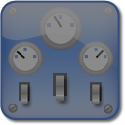
Agenda
Configuration Management
Change propagation
software Engineering disciplines
automation

Slide 7
Story Time!
THE PROBLEM WITH BEING THE FIRST UP THE MOUNTAIN: CONFIGURATION MANAGMENT
Setting: Early to Mid ‘90s
Objectives:
Maximize utilization of physical resources (before VMs, before containers)
Model deployment (language to describe everything)
Management abstractions (commoditize operational tasks)
The effort:
Shell-based framework: orthogonal tools and wrappers around metadata describing the state of a model
Configuration Management model as a translation of target application architecture
Results: Success
?

Slide 8

The unforeseen side effects: ‘configuration-itis’
Achieving a goal CANNOT not BE SUCCESS if IN DOING SO YOU LIMIT YOUR FUTURE POTENTIAL
Configuring at the leafs leads to diminishing returns
Treating an environment atomically is a recipe for environment instability
Configuration data, with respect to the model, is not truly orthogonal
Result: ‘Sherpa’ support for metadata needed, deployments are complex

Slide 9
How to safely descend the mountain
DO not waste your time: Do not configure, standardize
Do not configure environments. Instead, set production standards. If needed, configure exceptions only
Set up base camps: Divide and conquer
Environments, must be divided in availability zones, each isolated from each other*
ELIMINATE WASTE: Loose the redundancies
In large scale-systems, redundancies in descriptive models will lead to implementation ambiguities, thus complicating refactoring or migrations. Ensure there is only one unambiguous way of describing state
CARRY YOUR OWN EQUPMENT: THE ART OF DELEGATING CONFIGURATION TASKS
Your support teams, your Sherpa, are there to serve as SMEs, find and suggest routes and offer advice. You should carry your own life-saving equipment. In other words: own your configuration, but get expert advice in automation and tools.

Slide 10


Agenda
Configuration Management
Change propagation
software Engineering disciplines
automation

Slide 11
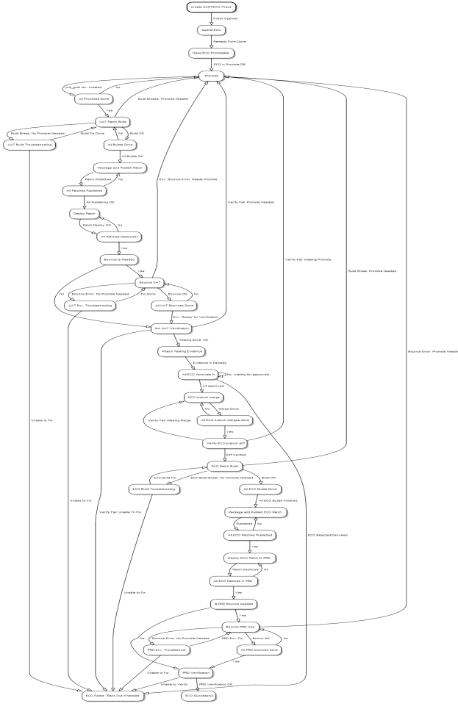
What is change propagation?
Understanding value flows
Deep, value stream mapping
Only Production is Production, everything else is an approximation
Change propagation should increase the accuracy (value) of approximations (testing environments)
Promoting the Code vs. Bits

Slide 12
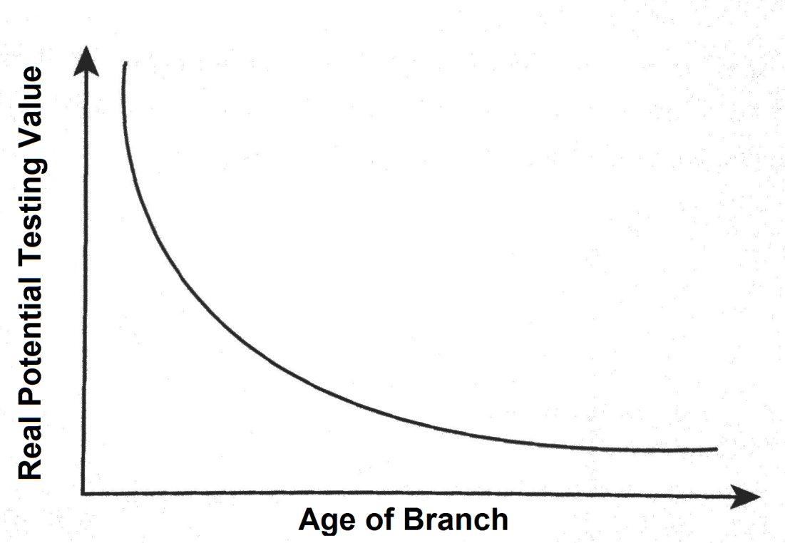
Change Propagation and SCM
The danger of using version control as program flow
Long-lived branches are rarely are needed, the decision to use one should be based on understanding the following

Slide 13
Change Propagation Shapes
STAIRCASE
Often used with long-lived branches
SLIDE
Often used with in main-line development
DVL
Merging Code
SIT
Validating Bits
DIT
DVL
UAT
DIT
SIT
PRD
UAT
PRD
Poor approximations: different metadata, different applications
Good approximations: different metadata, same applications

Slide 14
How to do Change Propagation
PIT FALLS AND HOW TO AVOID THEM
Long-lived branches and/or staircase change propagation leads to: ‘environment-itis’
The solution to environment stability problems is not more environments
Engage any Internal Audit and Change Management departments early on. Even an ITIL purist can be a partner. Build tools for them.
Establish, bit-based certifications
Sign all your deliverables
FinTech Point DEEM process to establish successful change propagation
Minimize use of long-lived branched
Define Acceptability Criteria
Encourage bit-based Promotion
Engage Internal Audit

Slide 15


Agenda
Configuration Management
Change propagation
software Engineering disciplines
automation

Slide 16
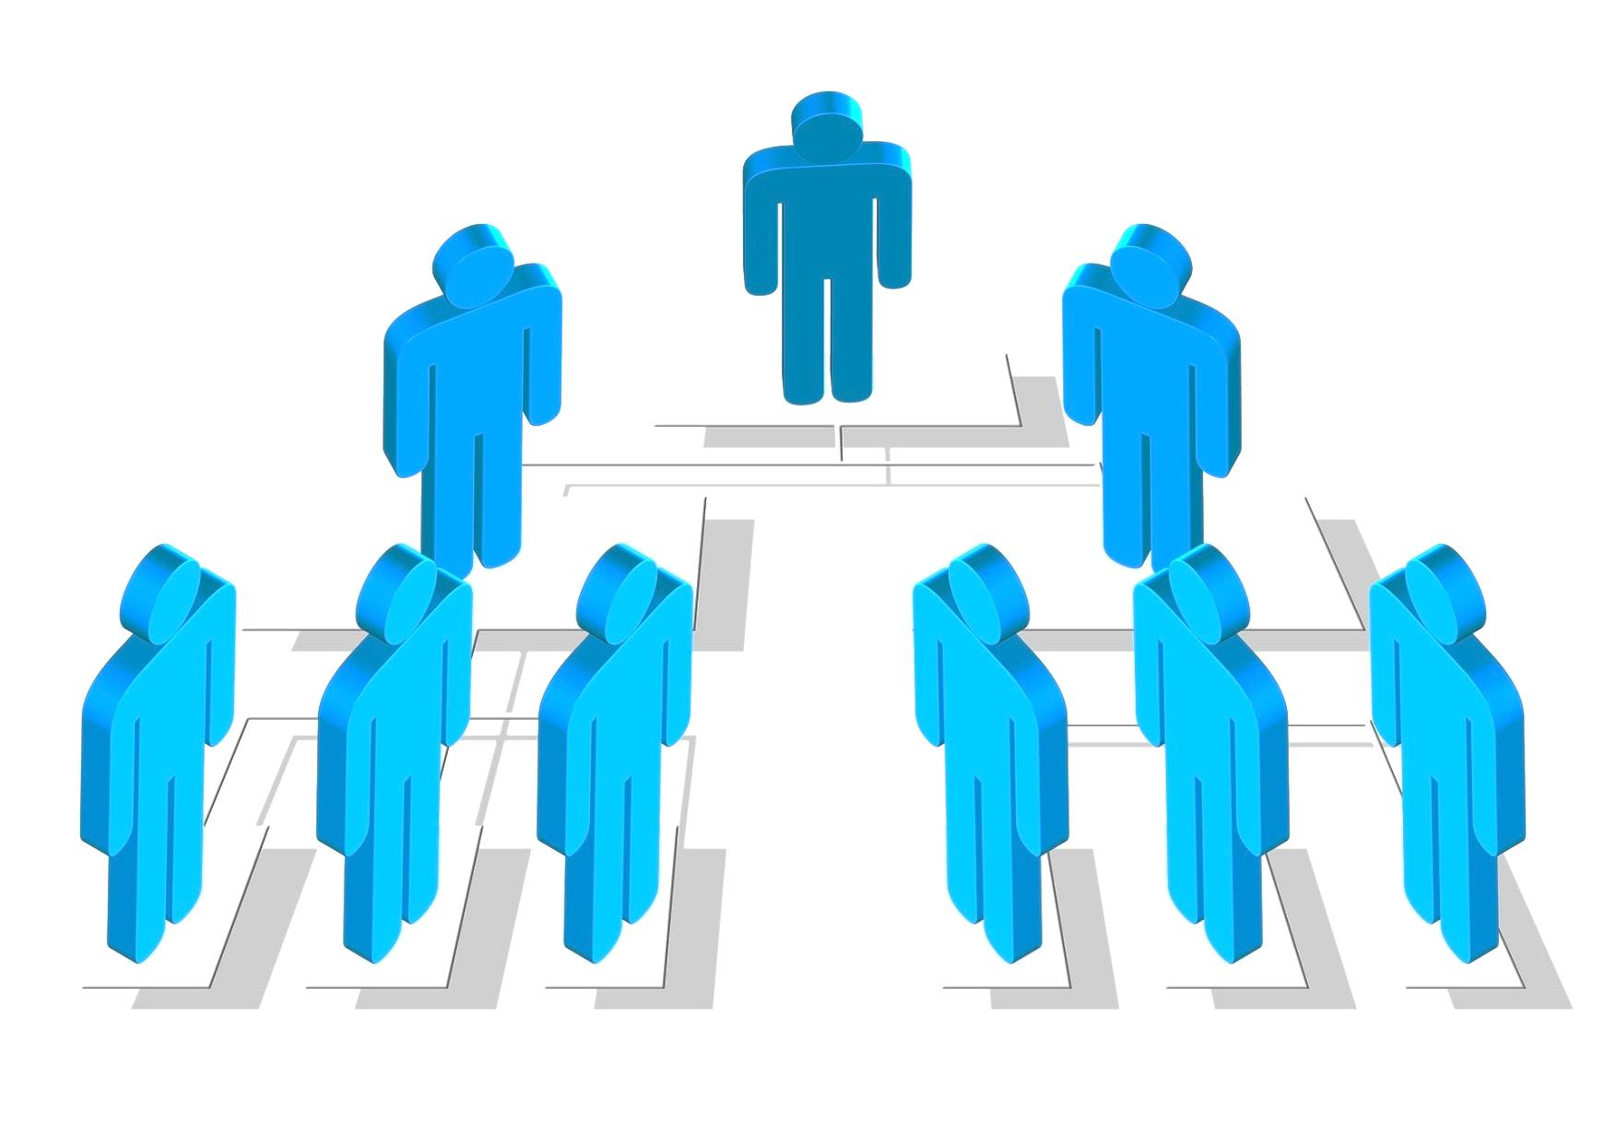
Conway’s Law
“organizations which design systems ... are constrained to produce designs which are copies of the communication structures of these organizations”
-Mel Conway

Slide 17
Software Engineering Disciplines, do’s and don’ts
DO
Have developers own unit and functional testing
Treat functional testing as code
Have Ops embedded with Dev
Commit every day
Draw clear lines around applications
If branches are used, integrate everyday
Version everything, even second-level components
Use application independent deployment gates (e.g.: load balancers, proxies, web routers)
Branch by abstraction
Promote your bits
Be nice
DO NOT
Use branches as feature toggles
Turn off unit testing
Delegate test design/ownership
Draw clear lines around people
Use SNAPSHOT versions
Use hostnames in configurations (abstract network endpoints)
Leave un-promoted code on lower branches
Commit untested code right before leaving
Assume anything

Slide 18
Software Engineering Disciplines, this is the hardest part
12-step program to modernizing a deployment pipeline in a large risk conscious organization:
Identify a progressive team
Measure
Listen to that team
Offer CI and training
Listen again
Delivery a POC CD implementation
Measure
Engage regulatory bodies to vet tools and processes
Using quantitative data, get senior leadership buy-in
Slowly, incrementally deploy CI to other teams
Slowly, incrementally deploy CD to other teams
Rinse and repeat
The Triangle of Deployment Agility
Build time to Run time verification (B2RV)
Run time verification failure to fix build start (RVF2B)
Build failure to build success (BF2B)
Minimize the area

Slide 19

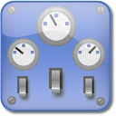
Agenda
Configuration Management
Change propagation
software Engineering disciplines
automation

Slide 20
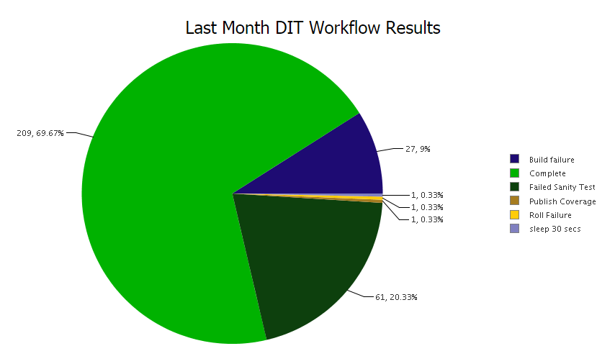
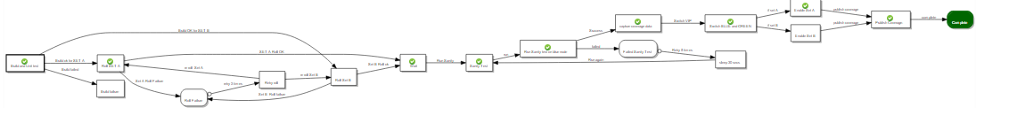
Automation
What it looks like, the results
Simplified configuration management, slide change propagation shape, rigorous software engineering disciplines and awesome automation with ElectricFlow
Automated:
Network-level tasks (load balancer)
Build
Unit test data aggregation and publishing
Test node provisioning and configuration
Deployment
Functional Testing
Reporting

Slide 21
Automation
ElectricFLOW usage, practical tips
Automation is documentation
Automation provides the best audit tail
Concentrate on high-quality factory procedures and re-usable sub-procedures
Set and enforce standards
Create tool ownership

Slide 22
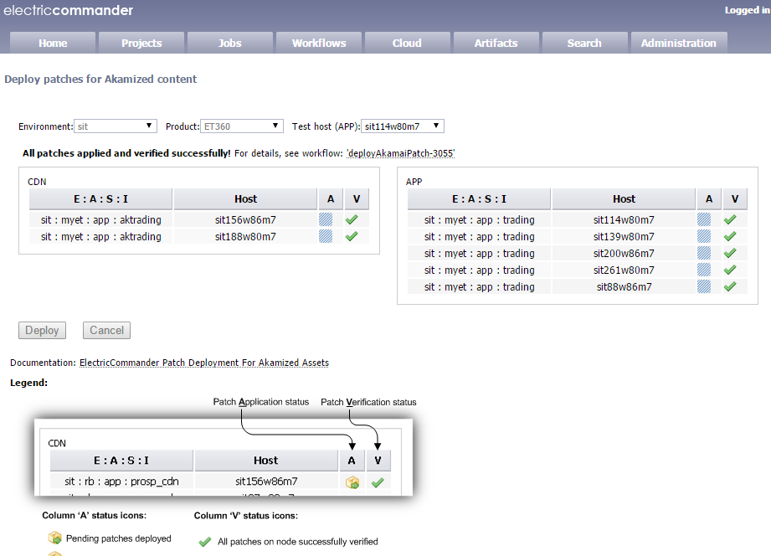
Automation
More electricflow Tips
Use properties for all external variables
Use credential management
Create your own plugins (improve UI)
Back up everything
Have tight access control
Train everyone!

Slide 23

So, how does Wall Street does Continuous Delivery?
In large, legacy-heavy industries, with multiple dimensions of regulations and a very conscientious appetite for risk, the most difficult part is not the tooling, but gaining momentum for a cultural pivot. This is achieved only when there is top-bottom buy-in. At E*TRADE, Continuous Delivery has been a key methodology to deliver the best tools to investors, implemented thanks to a tech leadership that sees the importance of not only continuous, but flawless delivery.

Slide 24
Thank You
Q&A

